Slide 1

Code Coverage
Group G
Huynh Gia Dat - 19125038 - hgdat19@apcs.fitus.edu.vn
Pham Hoang An - 19125078 - phan19@apcs.fitus.edu.vn
Le Chau Nhat Quang - 19125116 - lcnquang19@apcs.fitus.edu.vn

Slide 2
What is code coverage?
Software testing metric
Determines the number of lines of code that is successfully validated under a test procedure
Analyze how comprehensively a software is verified.
Developers: Dead code detection and elimination.
QA Engineer: Check missed or uncovered test cases.
Notes:
QA Engineer: They can track the health status and quality of the source code while paying more heed to the uncaptured parts of the code.

Slide 3

How is it measured?

Slide 4
5 code coverage criteria
Function Coverage
Statement Coverage
Branches Coverage
Condition Coverage
Line Coverage
Notes:
Code coverage tools will use one or more criteria to determine how your code was exercised or not during the execution of your test suite. The common metrics that you might see mentioned in your coverage reports include:
Function coverage: how many of the functions defined have been called.
Statement coverage: how many of the statements in the program have been executed.
Branches coverage: how many of the branches of the control structures (if statements for instance) have been executed.
Condition coverage: how many of the boolean sub-expressions have been tested for a true and a false value.
Line coverage: how many of lines of source code have been tested.
These metrics are usually represented as the number of items actually tested, the items found in your code, and a coverage percentage (items tested / items found).

Slide 5
Example
Add (int a, int b) {
If (b > a) {
b = b - a
Print b
}
If (a > b) {
b = a – b
Print b
}
Else Print ‘0’
}
Notes:
Statement Coverage: For example, in the above source code if input values are taken as 2 & 3 then, the ‘Else’ part of the code would not get executed. However, if the input values are of type 3 & 2 then the ‘If’ part of the code would not get executed.
This means that with either set of values of our Statement Coverage would not be 100%. In such a case, we may have to execute the tests with all three [(2, 3), (3, 2), (0, 0)] set of values to ensure 100% Statement Coverage.
Function Coverage, for example,in the source code above if our tests call the ‘Add’ function even once, then we would call this as a complete Function Coverage.
Condition Coverage, for example, in the above code if value sets (2, 3) and (4, 2) are used then Condition Coverage would be 100%. When data set (2, 3) is used then (b > a) evaluates to true and (a > b) evaluates to false. Similarly, when data set (4, 2) is used then (b > a) evaluates to false and (a > b) evaluates to true.
Thus both the conditions have both the values i.e true and false covered. Hence the Condition Coverage would be 100%.
Branch Coverage, for example, in the above code if value sets (2, 3), (4, 2), (1, 1) are used then Branch Coverage would be 100%. When data set (2, 3) is used then (b > a) and the first ‘If’ branch gets executed. Similarly, when data set (4, 2) is used then (a > b) evaluates to true and the second ‘If’ branch gets executed.
Then with the data set (1, 1) the ‘Else’ branch evaluates to true and gets executed. Thereby, ensuring 100% Branch Coverage
Line Coverage, calculating test coverage is actually fairly easy. You can simply take the number of lines that are covered by a test (any kind of test, across your whole testing strategy) and divide by the total number of lines in your application.

Slide 6
Benefits
Easy maintenance of code base
Exposure of bad code
Faster time to market
Notes:
Easy maintenance of code base – Writing scalable code is crucial to extend the software program through the introduction of new or modified functionalities. However, it is difficult to determine whether the written code is scalable. It can prove to be a useful metric in that context The analysis report will help developers to ensure code quality is well-maintained and new features can be added with little-to-no efforts.
Exposure of bad code – Continuous analysis will help developers to understand bad, dead, and unused code. As a result, they can improve code-writing practices, which in turn, will result in better maintainability of the product quality.
Faster time to market – With the help of this metric, developers can finish the software development process faster, thereby increasing their productivity and efficiency. As a result, they will be able to deliver more products, allowing companies to launch more software applications on the market in lesser time. This will undoubtedly lead to increased customer satisfaction and high ROI.

Slide 7
Code Coverage Tools
Istanbul
dotCover
Coverage.py
SimpleCov
Jest
Code coverage tools will use to determine how your code was exercised or not during the execution of your test suite.

Slide 8
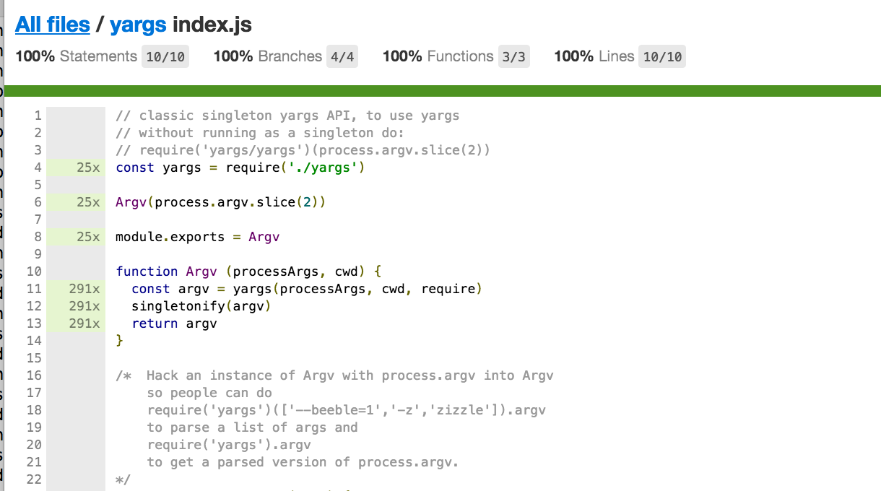


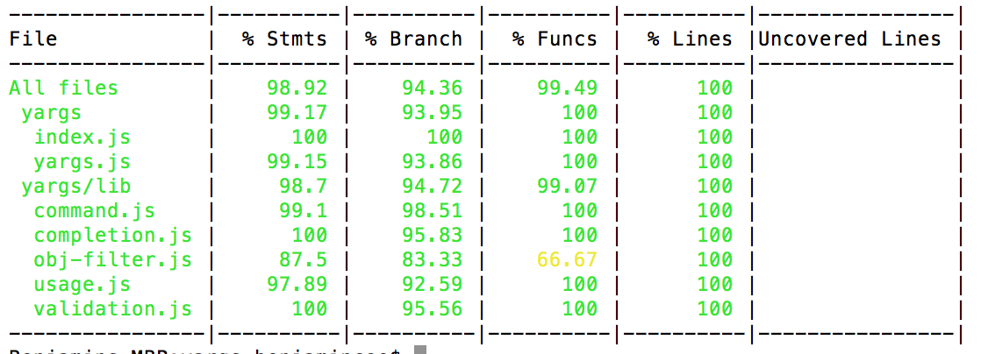
1 Istanbul
Istanbul instruments your ES5 and ES2015+ JavaScript code with line counters, so that you can track how well your unit-tests exercise your codebase.
The nyc command-line-client for Istanbul works well with most JavaScript testing frameworks: tap, mocha, AVA, etc.

Slide 9
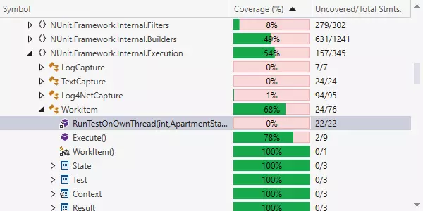
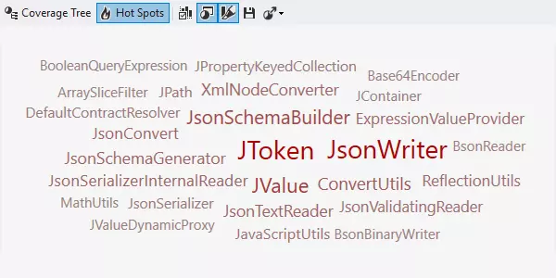
2 dotCover
JetBrains dotCover is a .NET unit test runner and code coverage tool that integrates with Visual Studio and JetBrains Rider.
Along with unit test run results, dotCover displays a coverage tree showing how thoroughly a particular project, namespace, type, or type member is covered with unit tests.
The Hot Spots view was designed to help you identify the most risky methods in your solution. Hot Spots are calculated in terms of high cyclomatic complexity and low unit test coverage of the methods.
Notes:
dotCover calculates and reports statement-level code coverage

Slide 10
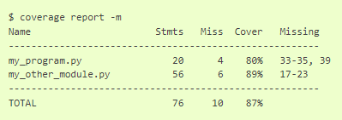
3 Coverage.py
Coverage.py is a tool for measuring code coverage of Python programs.
Coverage.py can do a number of things:
By default it will measure line (statement) coverage.
It can also measure branch coverage.
It can tell you what tests ran which lines.
It can produce reports in a number of formats: text, HTML, XML, and JSON.
For advanced uses, there’s an API, and the result data is available in a SQLite database.

Slide 11
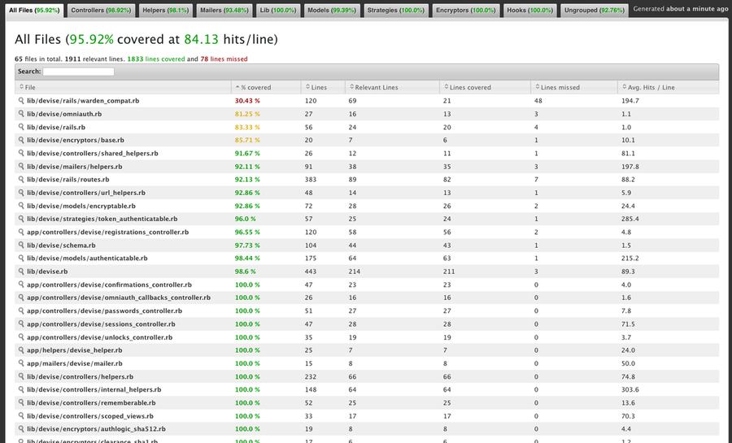
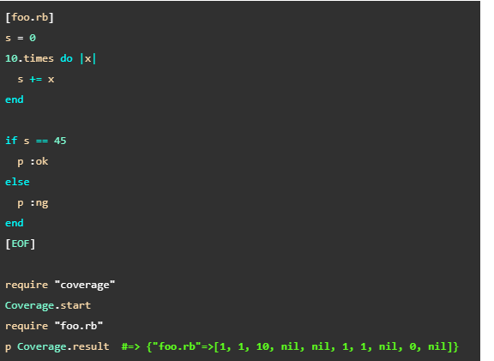
4 SimpleCov
SimpleCov is a code coverage analysis tool for Ruby. It uses Ruby's built-in Coverage library to gather code coverage data, but makes processing its results much easier by providing a clean API to filter, group, merge, format, and display those results, giving you a complete code coverage suite that can be set up with just a couple lines of code.

Slide 12
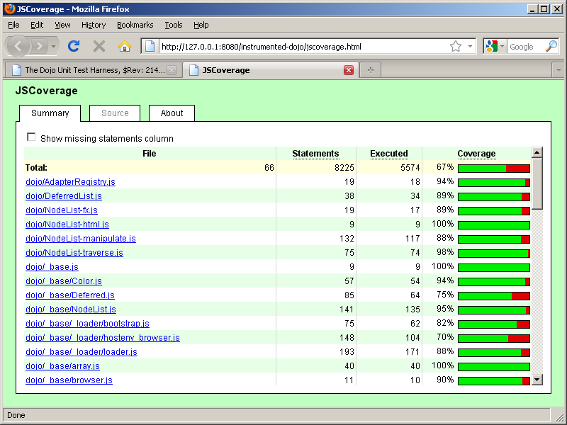
4 JSCoverage
JSCoverage is a tool that measures code coverage for JavaScript programs.
Code coverage statistics show which lines of a program have been executed (and which have been missed). This information is useful for constructing comprehensive test suites (hence, it is often called test coverage).
JSCoverage works by instrumenting the JavaScript code used in web pages. Code coverage statistics are collected while the instrumented JavaScript code is executed in a web browser.
JSCoverage works with any modern standards-compliant web browser - including Internet Explorer (IE 6, 7, and 8), Firefox, Opera, Safari, and Google Chrome - on Microsoft Windows and GNU/Linux.

Slide 13
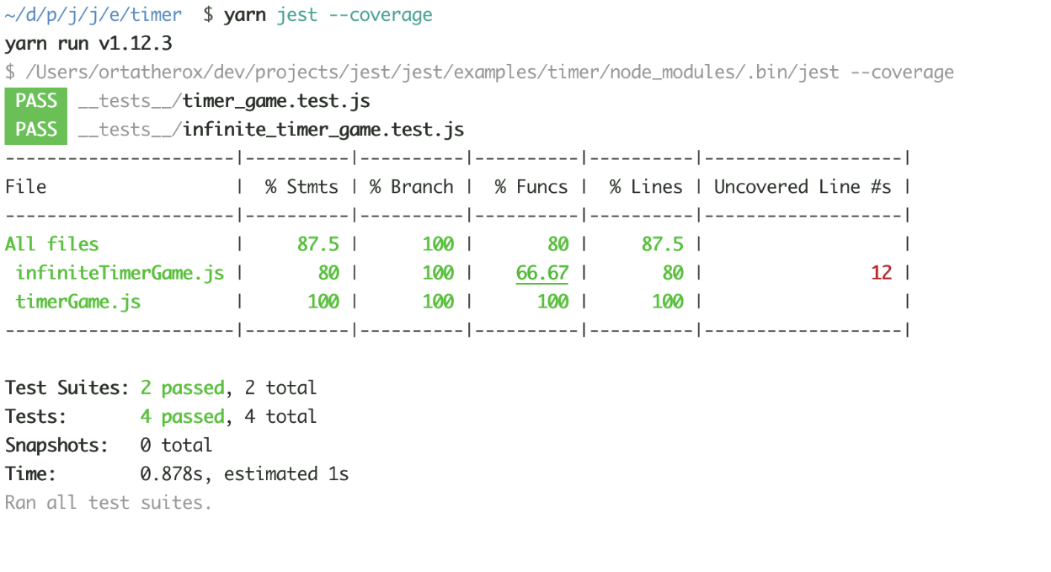
5 Jest
Jest is a delightful JavaScript Testing Framework with a focus on simplicity.
It works with projects using: Babel, TypeScript, Node, React, Angular, Vue and more!
Generate code coverage by adding the flag --coverage. No additional setup needed. Jest can collect code coverage information from entire projects, including untested files.

Slide 14
DEMO

Slide 15
Jest - Getting started
Installation:
npm: npm install --save-dev jest
Yarn: yarn add -D jest
Additional Configuration for using Babel and TypeScript:
npm: npm install --save-dev babel-jest @babel/core @babel/preset-env @babel/preset-typescript or Yarn: yarn add -D babel-jest @babel/core @babel/preset-env @babel/preset-typescript
Generate a Jest basic configuration file: jest --init
Create babel.config.js file with content:
module.exports = {
presets: [
['@babel/preset-env', {targets: {node: 'current'}}],
'@babel/preset-typescript',
],
};

Slide 16
Jest - Note
jest --coverage only shown for the files that you’ve written test cases for and any files that those files happen to interact with → doesn’t give you a full picture of how covered your code is
Pass in an argument to jest: jest --coverage --collectCoverageFrom=’src/**/*.{js,jsx,ts,tsx}’
Or
Edit the file jest.config.js:
module.exports = {
collectCoverage: true,
collectCoverageFrom: ['src/**/*.{js,jsx}'],
};

Slide 17
How do Jest work in a bigger project?

Slide 18
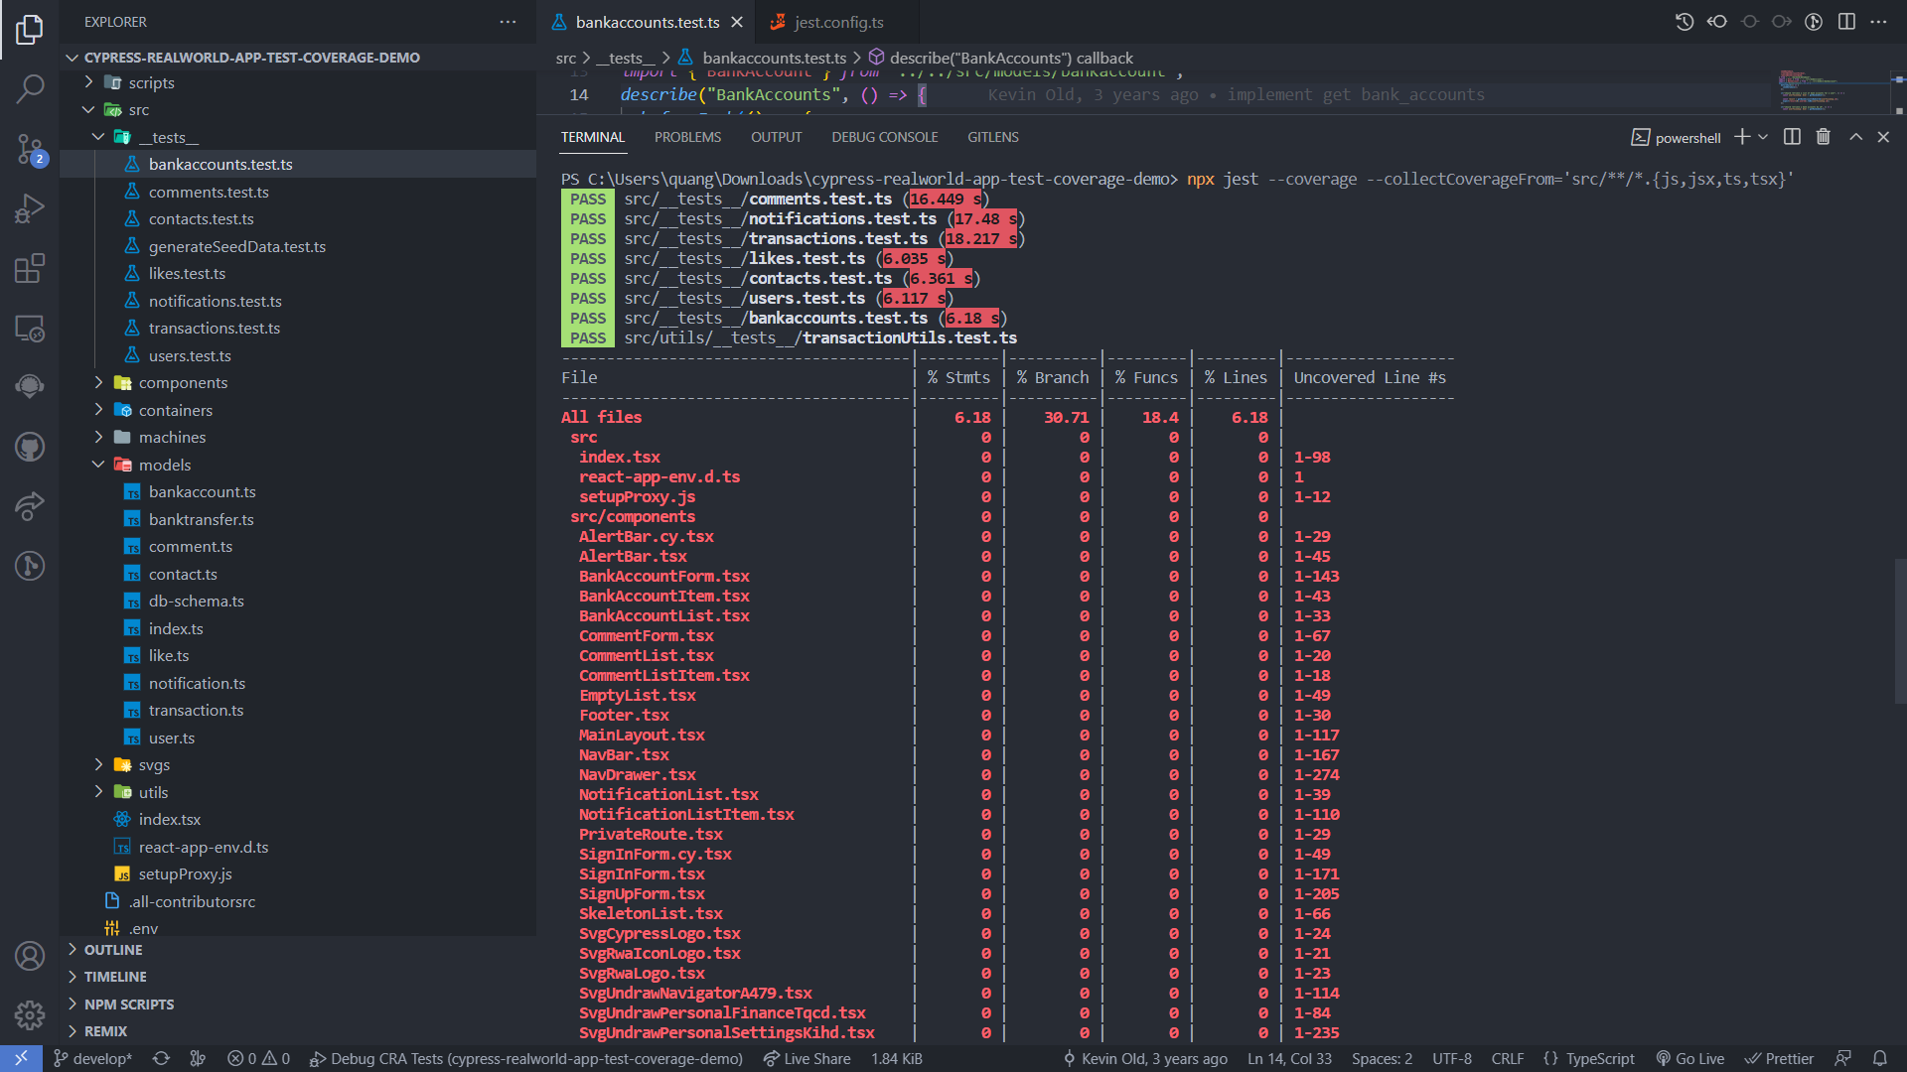

Slide 19
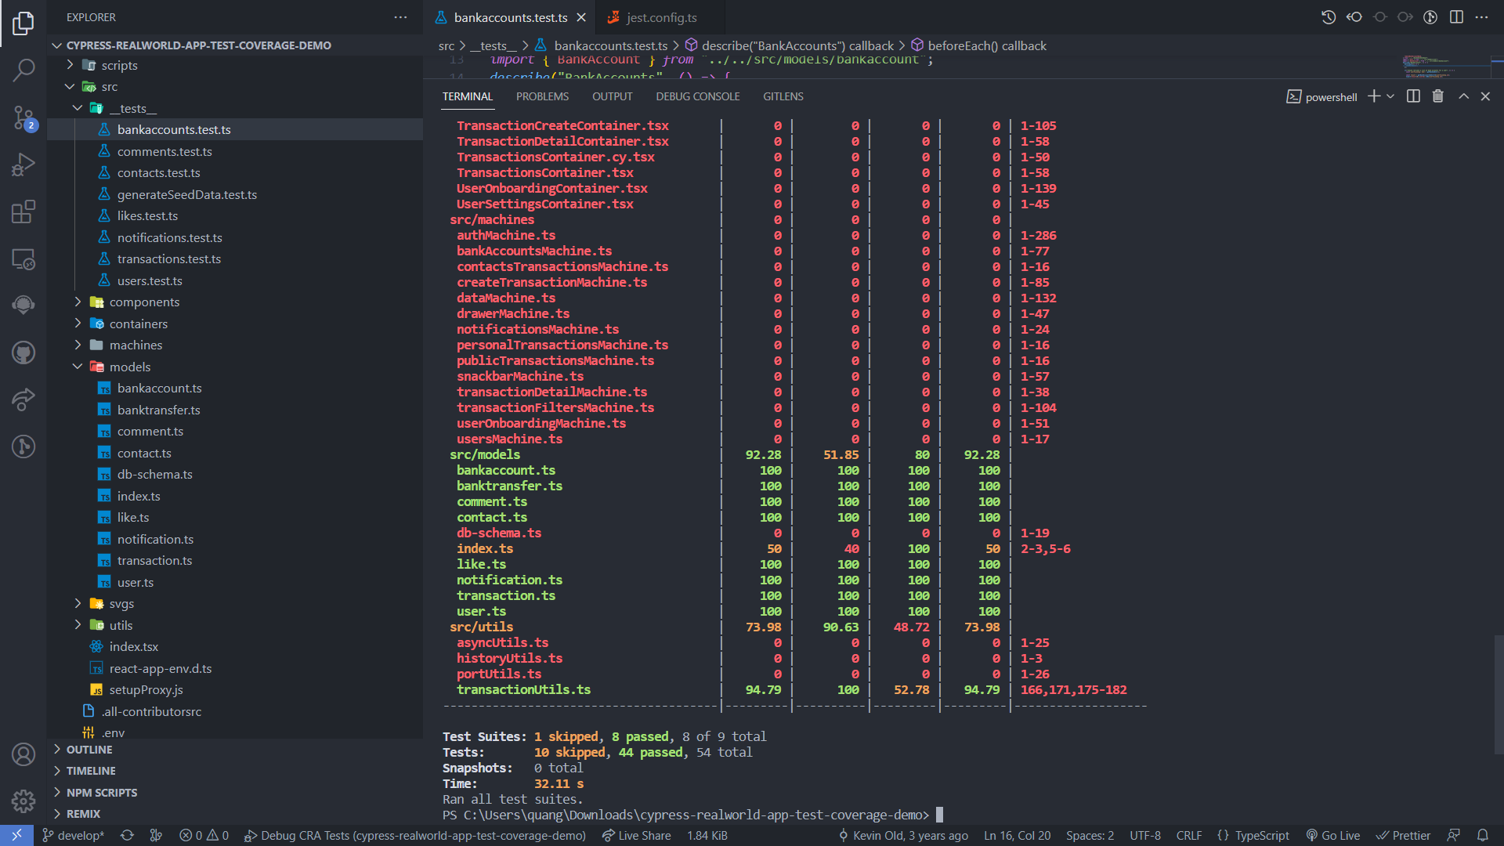

Slide 20
Conclusion
Achieving great coverage is an excellent goal, but it should be paired with having a robust test suite that can ensure that individual classes are not broken as well as verify the integrity of the system.

Slide 21

THANK YOU FOR PAYING YOUR ATTENTION

